Slide 1

Manager of Contacts

Slide 2
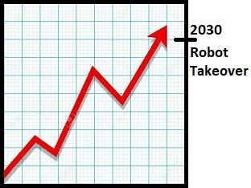

Contact Manager for Robots

Slide 3

Team Members
Andrew Nicely
Project Manager
API/Front-End
Vincent Barone
Front-End Design
Presentation
Ran Xu
API
Debugger
Junejae Kim
Back-End
Database

Slide 4
Gantt chart

Slide 5
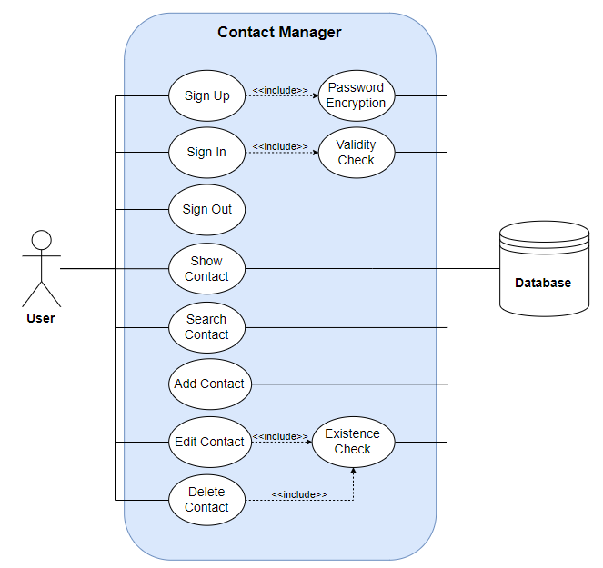
Use Case

Slide 6
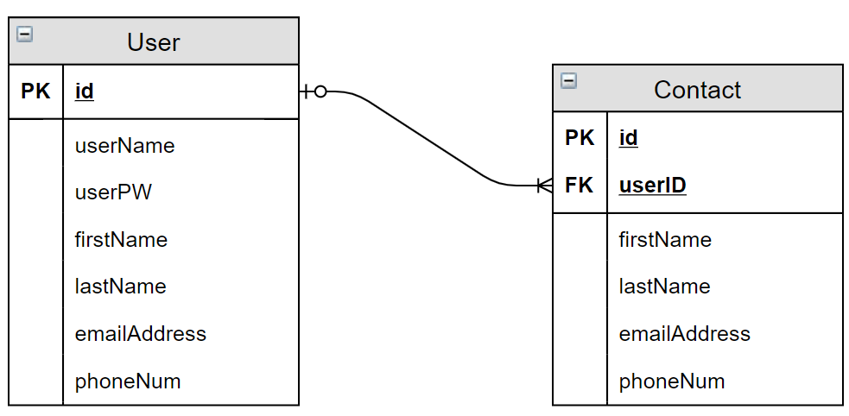
Entity Relationship

Slide 7
What went well? What did not?
Unable to connect to front-end
Front-end redesign required
Late presentation date
React

